Slide 1
Parameter-Efficient Fine-Tuning for Visual Question Answering: A Comparative Study
CMPT 728 Deep Learning
Sophia Yang & Qingrui Li
(301627219, 301400099)

Slide 2
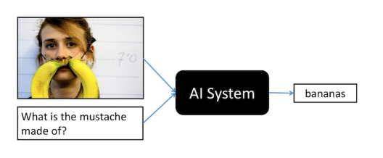
Problem & Motivation
What is VQA?
Image + Question → Answer
Challenge
Large models = billions of parameters
BLIP-2
ViLT
Full fine-tuning = Too expensive
Our Question
Can we adapt large models efficiently?

Slide 3
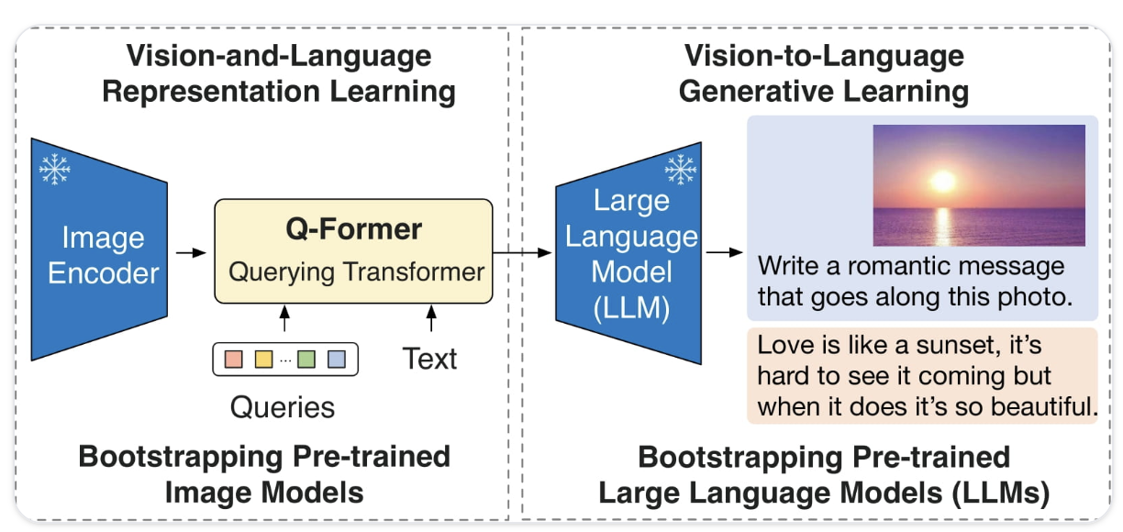
Model
BLIP-2 (OPT-2.7B): Bootstrapping Language-Image Pre-training with Frozen Image Encoders and Large Language Models

Slide 4
Methods
Base Model: BLIP-2 (OPT-2.7B)
Frozen backbone
Train small modules only
PEFT Methods
LoRA → low-rank updates
Adapters → small layers
IA³ → scaling vectors
Dataset
VQA v2
Train: 30K | Test: 3K
Training Setup
3 epochs
Batch size: 2 × grad accum 4 → 8
Optimizer: AdamW

Slide 5
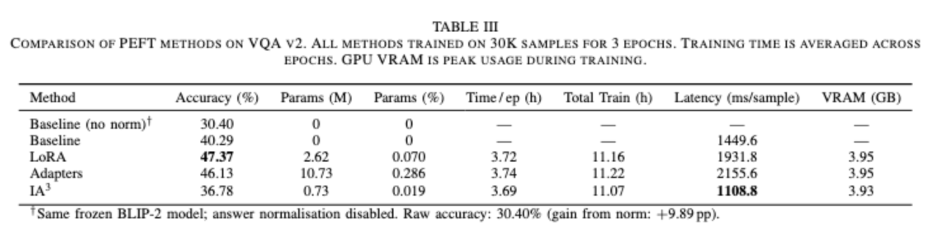
Result
Note:
• Apply answer normalization (e.g., “2 people” → “2”)
• Improves baseline: +9.89%

Slide 6
Conclusion
Key Takeaways
✅ LoRA = best accuracy-efficiency trade-off
⚖️ Adapters = good but heavier
⚡ IA³ = fastest but lower accuracy
Limitations
Small training subset (30K)
Only tune language model
Heuristic normalization
Future Work
More data
Tune Q-Former
Combine PEFT methods

Slide 7
Reference
Goyal, Y. et al. (2017). Making the V in VQA Matter. (CVPR)
Houlsby, N. et al. (2019). Parameter-Efficient Transfer Learning for NLP. (ICML)
Hu, E. et al. (2022). LoRA: Low-Rank Adaptation of Large Language Models. (ICLR)
Kabir, R. et al. (2024). Survey on VQA Datasets and Algorithms.
Kim, W. et al. (2021). ViLT: Vision-and-Language Transformer without convolution or region supervision.
Li, J. et al. (2023). BLIP-2: Bootstrapping Language-Image Pre-training with Frozen Encoders.
Liu, H. et al. (2022). IA³: Efficient Fine-Tuning vs In-Context Learning. (NeurIPS)

Slide 8
Thank You !

Slide 9
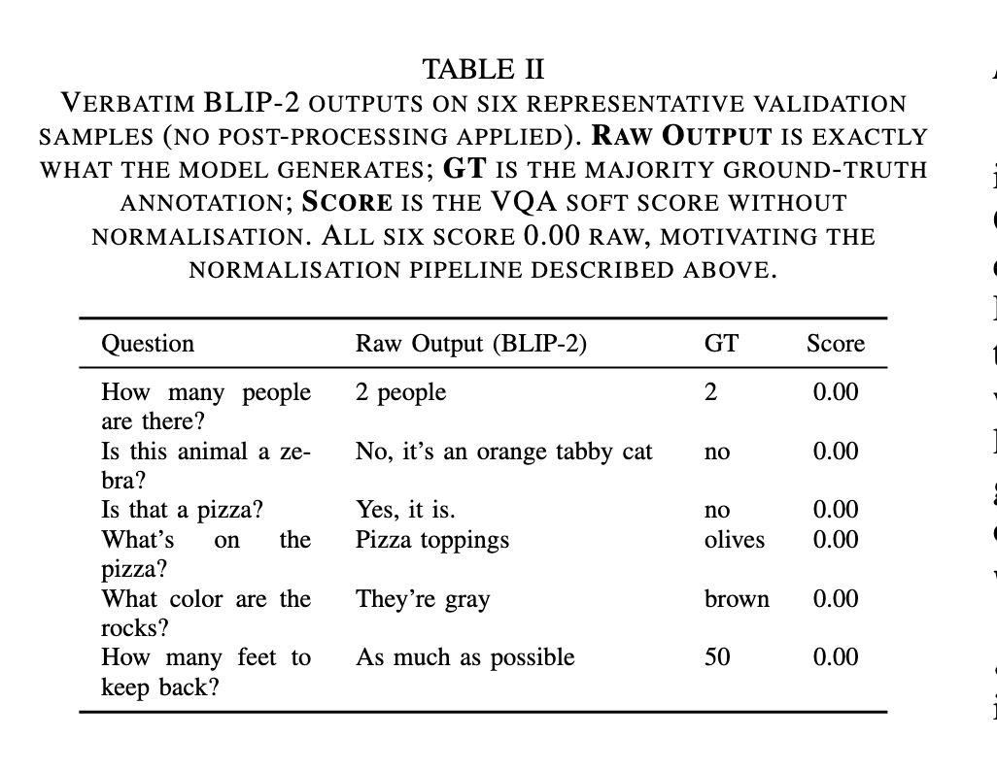
Appendix: Why Normalization is Needed
Problem: Generative Output Mismatch
Model outputs: full sentences
VQA expects: short answers

Slide 10
Appendix: Normalization
Normalization Steps
Remove repeated tokens
Truncate at punctuation
Extract numbers
Convert yes/no phrases
Lowercase
Effect on Baseline
Without normalization: 30.40%
With normalization: 40.29%
+9.89% improvement

Slide 11
Appendix: Limitation of Normalization
Heuristic rules (not perfect)
May miss valid answers
“tree branch” vs “branch” → score 0
May under/overestimate accuracy

Slide 12
Appendix: LoRA (Low-Rank Adaptation)
Adds low-rank matrices to attention weights
Only trains small number of parameters
Keeps original weights frozen
Good balance of performance and efficiency

Slide 13
Appendix: Adapters
Inserts small bottleneck layers into model
Adds extra parameters per layer
More flexible but heavier than LoRA

Slide 14
Appendix: IA³
Scales activations using learned vectors
Extremely parameter-efficient
Very lightweight but limited capacity

Slide 15
Appendix: Comparsion
LoRA > Adapters > IA³ (in capacity)
IA³ > LoRA > Adapters (in efficiency)”

